Slide 1
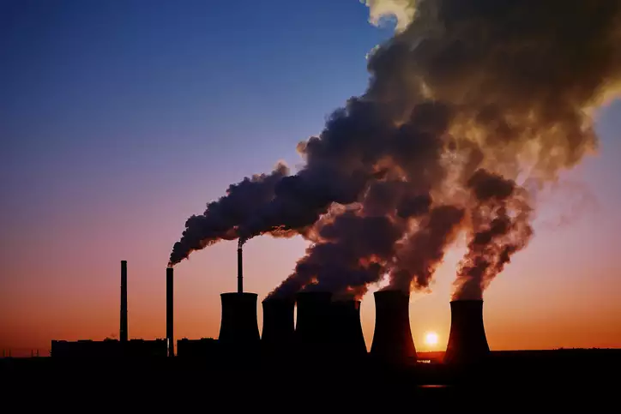



PROJECT - 1
AIR QUALITY
PREDICTION

Slide 2


AIR QUALITY INDEX
An air quality index (AQI) is used by government agencies to communicate to the public how polluted the air currently is or how polluted it is forecast to become. AQI information is obtained by averaging readings from an air quality sensor, which can increase due to vehicle traffic, forest fires, or anything that can increase air pollution.Pollutants tested include:
PM2.5
PM10
O3
SO2
CO
Particulate Matter
(2.5 micrometres)
Particulate Matter
(10 micrometres)
Trioxygen
Sulfur Dioxide
Carbon Monoxide

Slide 3



ARCHITECTURE DIAGRAM
01
Web Scrapping
02
Exploratory Data Analysis (EDA)
03
Feature Engineering
04
Machine Learning Model Training
05
Model Evaluation and Deployment

Slide 4
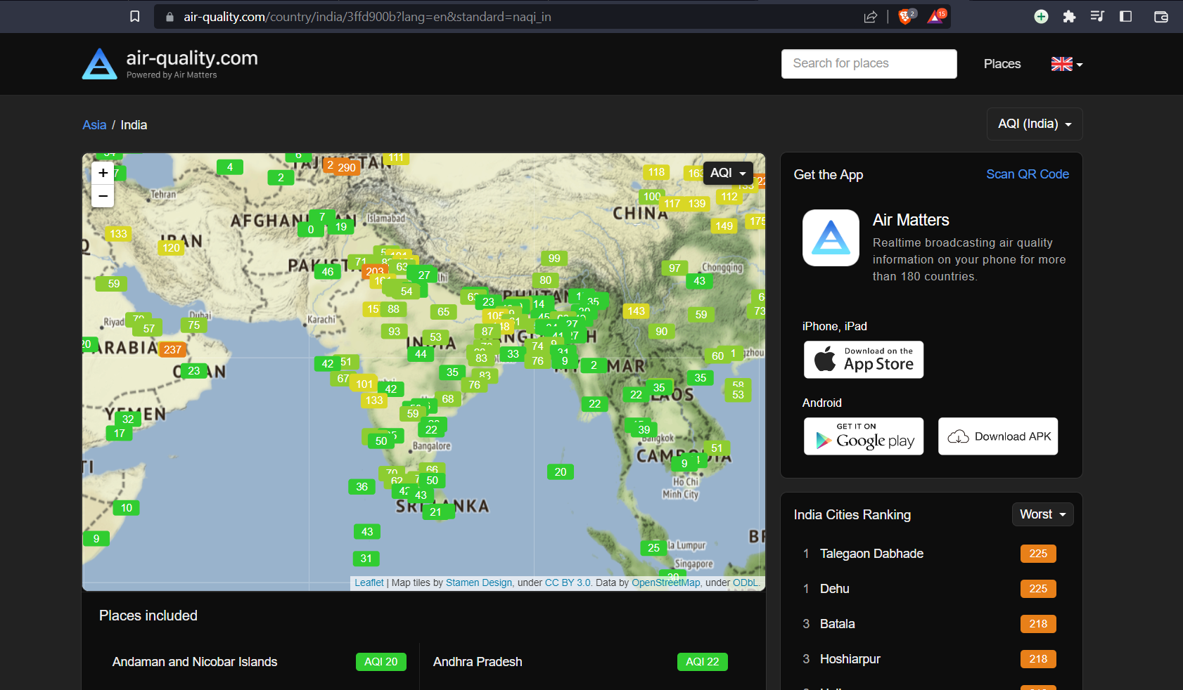
WEB SCRAPING SITE

Slide 5
BeautifulSoup
Beautiful Soup is a Python library used for web scraping. It allows you to parse HTML and XML documents, navigate the parse tree, and extract data from the documents in a convenient way. Web scraping is the process of extracting information or data from websites.
KNN Imputer
In order to fill-in for the missing values in our dataset we used the KNN Imputer that estimates the missing values based on the KNN algorithm.
TECH STACK USED
PowerTransformer
We used the PowerTransformer class from sklearn.preprocessing in order to scale the numerical features in our dataset.
BaggingRegressor
After running our dataset on various models, we found out that BaggingRegressor is performing the best.

Slide 6
PROBLEM FACED
01
Identifying a reliable source of air quality data for urban areas that permits the users to extract data via web-scraping.
02
Cleaning the extracted data and handling the missing values in it, as well as scaling our data in order to get accurate predictions from our model.
03
Finding out which model performs the best on our dataset to predict target feature accurately.

Slide 7
SOLUTIONS
01
Researched and found out a website that meets the project requirements.
02
Handled the missing values using Iterative Imputing techniques. Also worked with various feature scaling techniques to find out what works the best.
03
Trained and tested our dataset on different models and based on the MSE values got the model that works the best.

Slide 8

THANK YOU

